Slide 1

FAKE NEWS DETECTION Department of Computer Science, University of Illinois Springfield CSC 535: Deep Learning
DECEMBER 08, 2020
Antone Evans Jr.
Notes:
© Copyright PresentationGO.com – The free PowerPoint and Google Slides template library

Slide 2
OVERVIEW
O1
PROJECT DESCRIPTION
DATA EXPLORATION AND PREPROCESSING
O2
O3
TRAINING MODELS
RESULTS
O4
O5
CONCLUSION
Notes:
© Copyright PresentationGO.com – The free PowerPoint and Google Slides template library

Slide 3
SECTION 1
O1
PROJECT
DESCRIPTION
Notes:
© Copyright PresentationGO.com – The free PowerPoint and Google Slides template library

Slide 4
PROJECT DESCRIPTION
SECTION 1
The purpose of this project was the detect fake news detection based on the given article.
Notes:
© Copyright PresentationGO.com – The free PowerPoint and Google Slides template library

Slide 5
SECTION 2
O2
DATA EXPLORATION
AND PREPROCESSING
Notes:
© Copyright PresentationGO.com – The free PowerPoint and Google Slides template library

Slide 6
SECTION 2
EXPLORING DATA
Notes:
© Copyright PresentationGO.com – The free PowerPoint and Google Slides template library

Slide 7
SECTION 2
The dataset was obtained from the IEEE Data Port
This dataset held 34,907 observations with 7 variables between two datasets – FakeNewsNet and Liar
6 object and 1 numeric variables
There was no missing values.
Notes:
© Copyright PresentationGO.com – The free PowerPoint and Google Slides template library

Slide 8
SECTION 2
INITIAL VARIBALES
id
date
speaker
statement
sources
paragraph_based_content
fullText_based_content
label_fnn
Notes:
© Copyright PresentationGO.com – The free PowerPoint and Google Slides template library

Slide 9
SECTION 2
PREPROCESSING
DATA
Notes:
© Copyright PresentationGO.com – The free PowerPoint and Google Slides template library

Slide 10
SECTION 2
INITIAL VARIBALES
id
date
speaker
statement
sources
paragraph_based_content
fullText_based_content
label_fnn
Notes:
© Copyright PresentationGO.com – The free PowerPoint and Google Slides template library

Slide 11
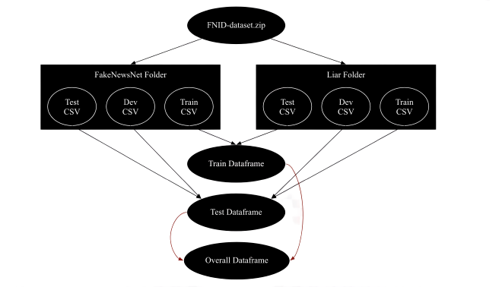
SECTION 2
Notes:
© Copyright PresentationGO.com – The free PowerPoint and Google Slides template library

Slide 12
SECTION 2
As seen in the previous slide we concatenated the dataset into 3 dataframes
Train, Test and Overall
The label variable was changed from an object to binary variable. 0 – fake and 1 – real
Notes:
© Copyright PresentationGO.com – The free PowerPoint and Google Slides template library

Slide 13
SECTION 2
CORRELATION BETWEEN THE OUTCOME AND CATEGORICAL VARIABLES
Notes:
© Copyright PresentationGO.com – The free PowerPoint and Google Slides template library

Slide 14
SECTION 2
VARIABLE | P-VALUE
date | 0.094
speaker | 0.014
statement | 0.039
sources | 0.039
paragraph_based_content | 0.226
fullText_based_content | 0.039
Notes:
© Copyright PresentationGO.com – The free PowerPoint and Google Slides template library

Slide 15
SECTION 2
There is a relationship found with:
speaker
statement
sources
fullText_based_content
No relationship found with:
date
paragraph_based_content
Notes:
© Copyright PresentationGO.com – The free PowerPoint and Google Slides template library

Slide 16
SECTION 2
CORRELATION BETWEEN THE OUTCOME AND NUMERIC VARIABLES
Notes:
© Copyright PresentationGO.com – The free PowerPoint and Google Slides template library

Slide 17
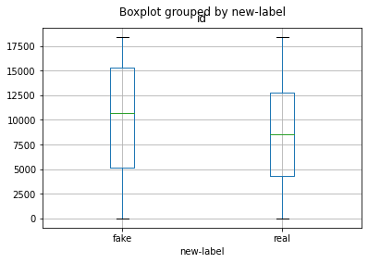
SECTION 2
P-VALUE:
0.00
Label Vs. ID Variable
Notes:
© Copyright PresentationGO.com – The free PowerPoint and Google Slides template library

Slide 18
SECTION 2
FINIAL VARIBALES
VARIABLE | TYPE | DESCRIPTION
label | int64 | Binary (1) Real or (0) Fake Label
text | object | Holds statement + “” + fullText _based_content fields
Notes:
© Copyright PresentationGO.com – The free PowerPoint and Google Slides template library

Slide 19
SECTION 2
TEXT
NIGRAMS
Notes:
© Copyright PresentationGO.com – The free PowerPoint and Google Slides template library

Slide 20
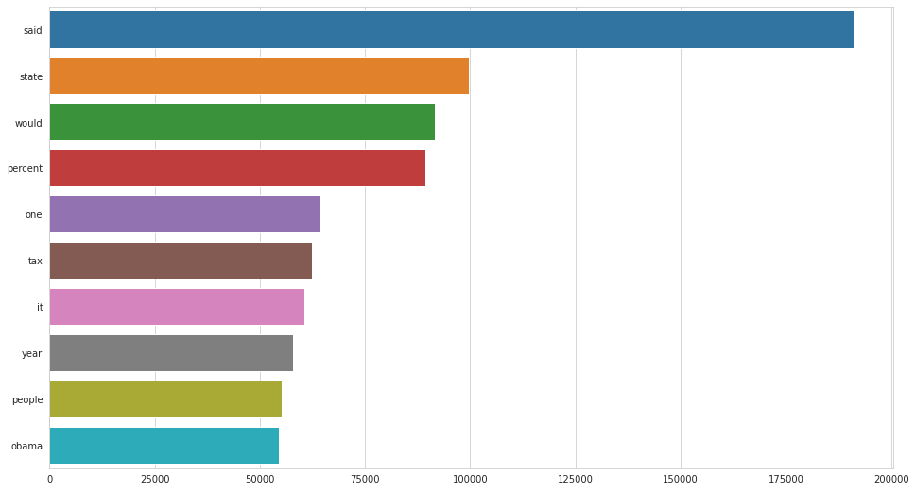
SECTION 2
Unigrams based on Frequency
Notes:
© Copyright PresentationGO.com – The free PowerPoint and Google Slides template library

Slide 21
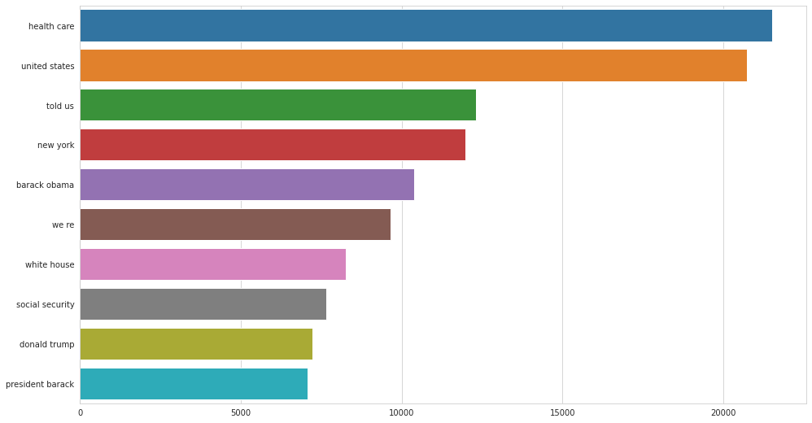
SECTION 2
Bigrams based on Frequency
Notes:
© Copyright PresentationGO.com – The free PowerPoint and Google Slides template library

Slide 22
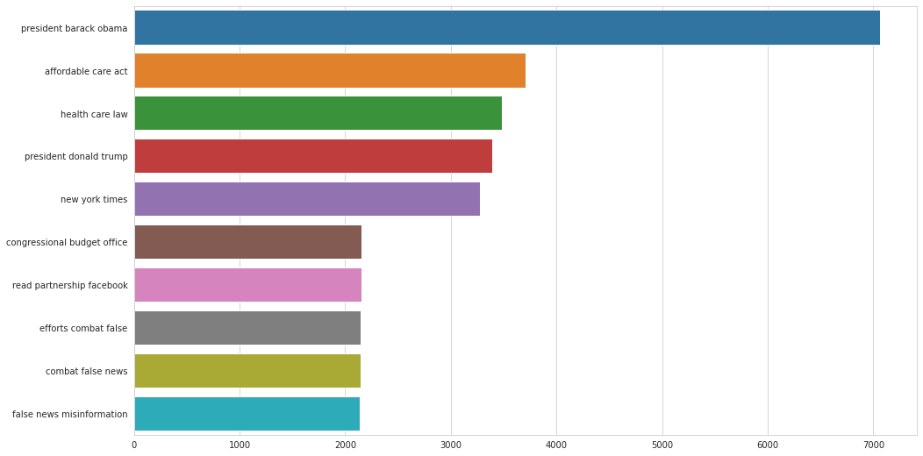
SECTION 2
Trigrams based on Frequency
Notes:
© Copyright PresentationGO.com – The free PowerPoint and Google Slides template library

Slide 23
SECTION 2
SPLITTING DATA BETWEEN TRAIN AND TEST
Notes:
© Copyright PresentationGO.com – The free PowerPoint and Google Slides template library

Slide 24
SECTION 2
Train contained 30,264 observations
Test contained 4,643 observations
Data was broken down to x/y train and x/y test
Notes:
© Copyright PresentationGO.com – The free PowerPoint and Google Slides template library

Slide 25
SECTION 2
TOKENIZATION AND MAX PADDING
Notes:
© Copyright PresentationGO.com – The free PowerPoint and Google Slides template library

Slide 26
SECTION 2
Tokenization was placed on the text variable
This converted all words to a corresponding number
Max padding was used to ensure all tokenized vectors were the same length
Max number of words in the tokenizer was set to 10,000 and max padding was set to 300
Notes:
© Copyright PresentationGO.com – The free PowerPoint and Google Slides template library

Slide 27
SECTION 2
Global Vectors for Word Representation (GloVe Embedding File)
Notes:
© Copyright PresentationGO.com – The free PowerPoint and Google Slides template library

Slide 28
SECTION 2
GloVe is an unsupervised learning algorithm for obtaining vector representations for words.
The GloVe file was loaded from Kaggle using the glove.twitter.27B.100d.txt
Notes:
© Copyright PresentationGO.com – The free PowerPoint and Google Slides template library

Slide 29
SECTION 2
Balancing Data using Oversampling
Notes:
© Copyright PresentationGO.com – The free PowerPoint and Google Slides template library

Slide 30
SECTION 2
Dataset has 20,529 real news articles and 14,378 fake
Models accuracies decreased between 1-3%.
Precision decreased between 1-13%
Recall and F1 scores decreased between 3-8%.
Oversampling was not used
Notes:
© Copyright PresentationGO.com – The free PowerPoint and Google Slides template library

Slide 31
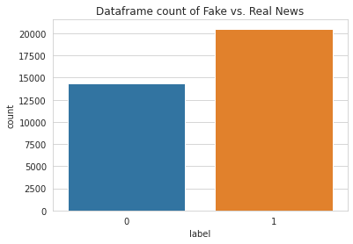
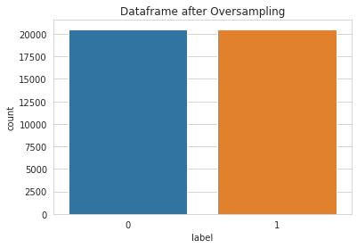
SECTION 2
Dataset without oversampling
Dataset with oversampling
Notes:
© Copyright PresentationGO.com – The free PowerPoint and Google Slides template library

Slide 32
SECTION 3
O3
TRAINING
MODELS
Notes:
© Copyright PresentationGO.com – The free PowerPoint and Google Slides template library

Slide 33
HYPOTHESIS
SECTION 3
Bidirectional LSTM RNN model would perform the best across the training data
GloVe would have the second highest accuracy
CNN model would have the lowest accuracy
Notes:
© Copyright PresentationGO.com – The free PowerPoint and Google Slides template library

Slide 34
SECTION 3
GloVe Model
Notes:
© Copyright PresentationGO.com – The free PowerPoint and Google Slides template library

Slide 35
INITIAL MODEL
SECTION 3
1 LSTM layer
No dropout layers
Notes:
© Copyright PresentationGO.com – The free PowerPoint and Google Slides template library

Slide 36
FINAL MODEL
SECTION 3
1 embedding layer with trainability turned off
LSTM layer with 128 neurons, a recurrent dropout and dropout of 0.25, and return_sequences turned off
LSTM layer with 64 neurons, a recurrent dropout and dropout of 0.10
Layer with 32 neurons and relu activation
Final layer with 1 neuron and sigmoid activation.
Model using batch size, epochs, learning rate, optimizer, and early stopping
Notes:
© Copyright PresentationGO.com – The free PowerPoint and Google Slides template library

Slide 37
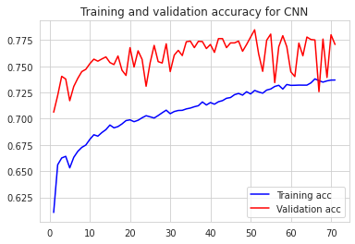
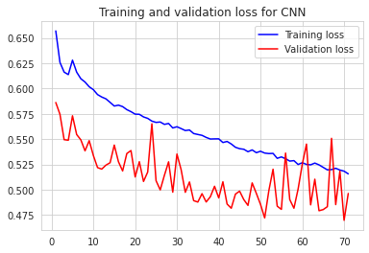
SECTION 3
Validation Accuracy of GloVe
Validation Loss of GloVe
Notes:
© Copyright PresentationGO.com – The free PowerPoint and Google Slides template library

Slide 38
SECTION 3
Bidirectional LSTM RNN Model
Notes:
© Copyright PresentationGO.com – The free PowerPoint and Google Slides template library

Slide 39
INITIAL MODEL
SECTION 3
No bidirectional layers
No dropout layers
Notes:
© Copyright PresentationGO.com – The free PowerPoint and Google Slides template library

Slide 40
FINAL MODEL
SECTION 3
1 embedding layer
Bidirectional LSTM layer with 64 neurons and return sequences turned off, another bidirectional LSTM layer with 16 neurons
Llayer with 64 neurons and relu activation with a dropout layer of 0.50
Final layer with 1 neuron and sigmoid activation.
Model using batch size, epochs, learning rate, optimizer, and early stopping
Notes:
© Copyright PresentationGO.com – The free PowerPoint and Google Slides template library

Slide 41
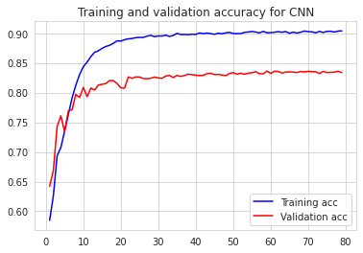
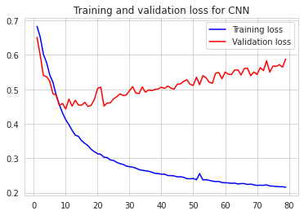
SECTION 3
Validation Accuracy of RNN
Validation Loss of RNN
Notes:
© Copyright PresentationGO.com – The free PowerPoint and Google Slides template library

Slide 42
SECTION 3
CNN
Model
Notes:
© Copyright PresentationGO.com – The free PowerPoint and Google Slides template library

Slide 43
INITIAL MODEL
SECTION 3
Former Data augmentation Model
Notes:
© Copyright PresentationGO.com – The free PowerPoint and Google Slides template library

Slide 44
FINAL MODEL
SECTION 3
1 embedding layer
Convolution 1D layer with 32 neurons and relu activation; a max pooling 1D layer followed by a flatten layer
Layer with 250 neurons and relu activation
Final layer with 1 neurons and sigmoid activation.
Model using batch size, epochs, learning rate, optimizer, and early stopping
Notes:
© Copyright PresentationGO.com – The free PowerPoint and Google Slides template library

Slide 45
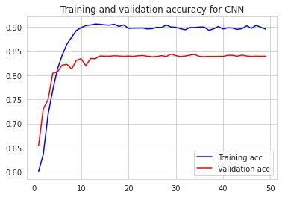
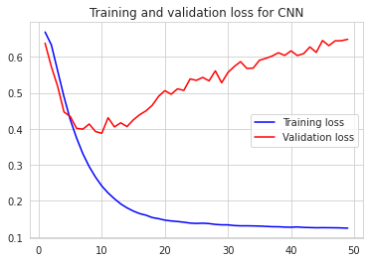
SECTION 3
Validation Accuracy of CNN
Validation Loss of CNN
Notes:
© Copyright PresentationGO.com – The free PowerPoint and Google Slides template library

Slide 46
SECTION 4
O4
RESULTS
Notes:
© Copyright PresentationGO.com – The free PowerPoint and Google Slides template library

Slide 47
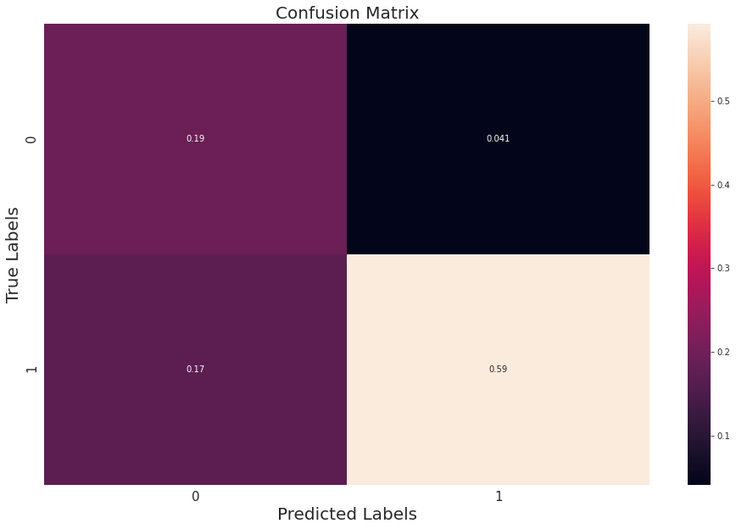
SECTION 4
GloVe Model Confusion Matrix
Notes:
© Copyright PresentationGO.com – The free PowerPoint and Google Slides template library

Slide 48
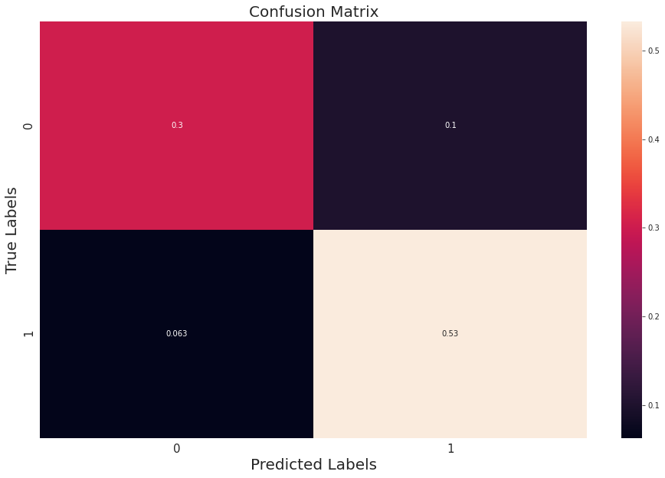
SECTION 4
RNN Model Confusion Matrix
Notes:
© Copyright PresentationGO.com – The free PowerPoint and Google Slides template library

Slide 49
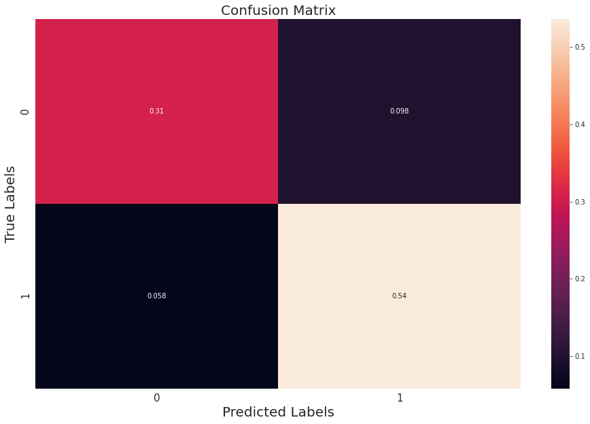
SECTION 4
CNN Model Confusion Matrix
Notes:
© Copyright PresentationGO.com – The free PowerPoint and Google Slides template library

Slide 50
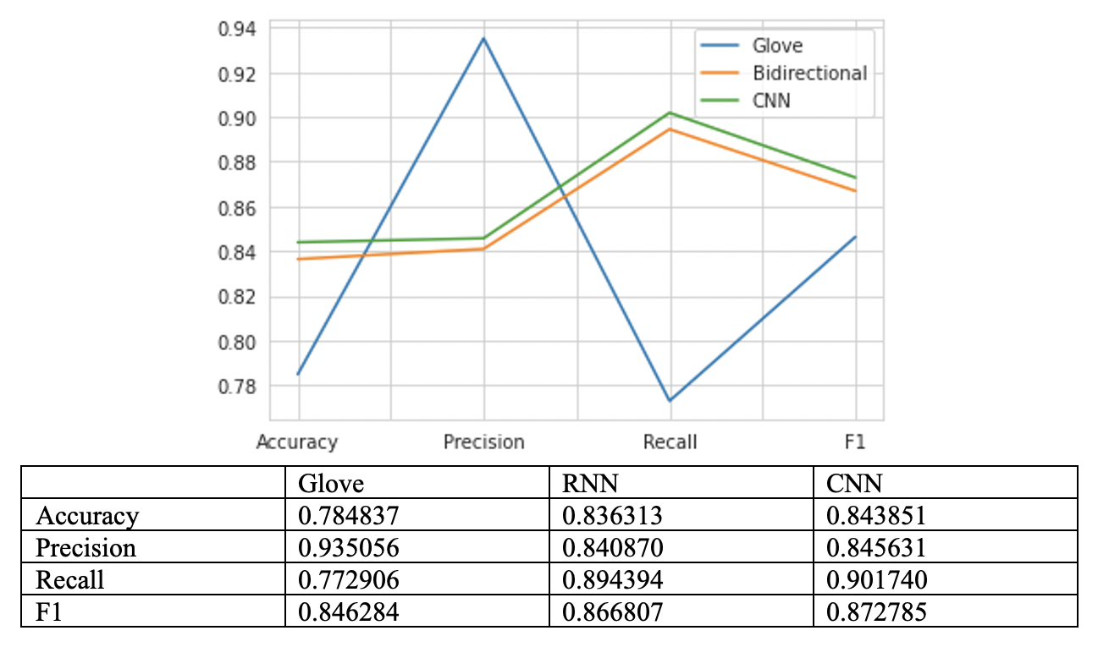
SECTION 4
Screen Shot 2020-12-03 at 5.00.26 PM
Notes:
© Copyright PresentationGO.com – The free PowerPoint and Google Slides template library

Slide 51
SECTION 5
O5
CONCLUSION
Notes:
© Copyright PresentationGO.com – The free PowerPoint and Google Slides template library

Slide 52
SECTION 5
CNN and RNN are less than a percent in accuracy after running the models multiple times
CNN is relatively the best choice as all precision, recall and f1 sources are relatively average.
The GloVe model although hypothesized to performed better. It under performed as it as the lowest accuracy, recall and f1 score although it has the highest precision
Notes:
© Copyright PresentationGO.com – The free PowerPoint and Google Slides template library

Slide 53
REFERENCES
SECTION 3
[1] (Dictionary.com, n.d.)
[2] (Mitchell, Jurkowitz, Oliphant, & Shearer, 2020)
[3] R. K. Kaliyar, "Fake News Detection Using A Deep Neural Network," 2018 4th International Conference on Computing Communication and Automation (ICCCA), Greater Noida, India, 2018, pp. 1-7, doi: 10.1109/CCAA.2018.8777343.
[4] Thota, Aswini; Tilak, Priyanka; Ahluwalia, Simrat; and Lohia, Nibrat (2018) "Fake News Detection: A Deep Learning Approach," SMU Data Science Review: Vol. 1 : No. 3 , Article 10.
[5] (Pennington, Socher, & Manning, 2014)
Notes:
© Copyright PresentationGO.com – The free PowerPoint and Google Slides template library

Slide 54
Thank You!
CREDITS: This presentation template was created by
www.presentationgo.com
Notes:
© Copyright PresentationGO.com – The free PowerPoint and Google Slides template library

